Slide 1

meetup
Apr 2026

Slide 2
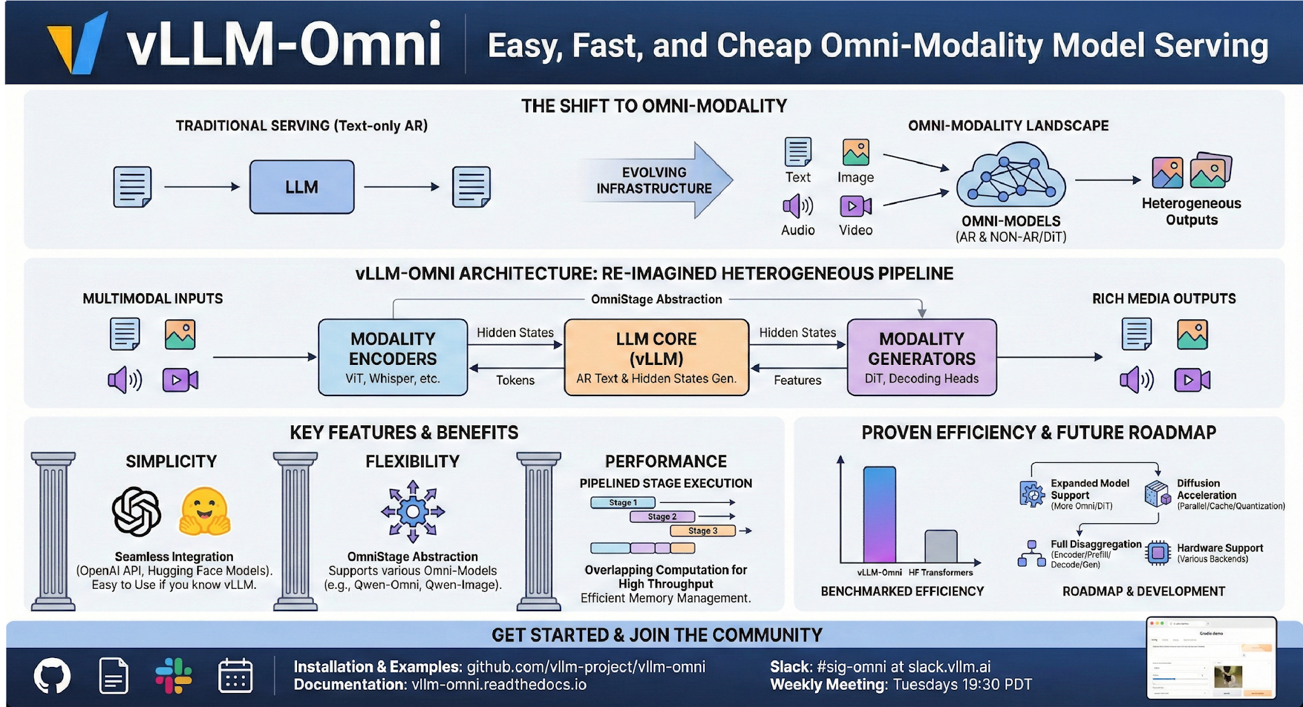
Stage
docs.vllm.ai/projects/vllm-omni/en/latest
Wednesday 19:30 PDT

Slide 3
Our Goal
Build the fastest and
easiest-to-use open-source
Omni-Modality model inference & serving engine

Slide 4
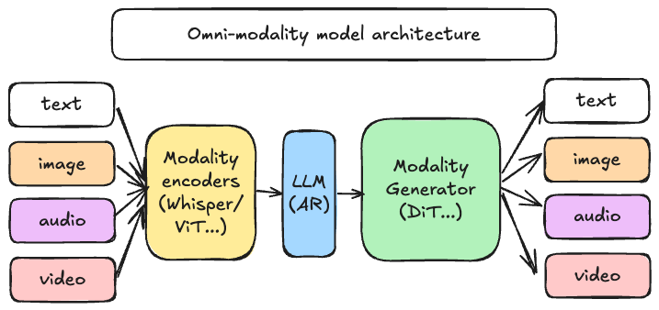
Omni-Modality models
Omni-modality: Text, image, video, and audio data processing
Non-autoregressive Architectures: extend the AR support of vLLM to Diffusion Transformers (DiT) and other parallel generation models
Heterogeneous outputs: from traditional text generation to multimodal outputs

Slide 5



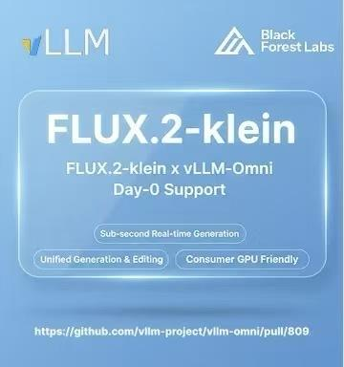






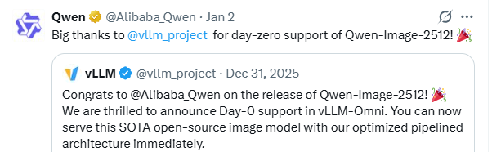





Broad Model Support
vLLM-Omni supports 40+ popular omni and diffusion model architectures(growing rapidly)
Qwen-Omni
Qwen-Image
BAGEL
LongCat
Mistral
Image/3D
SD3
Wan
MiMo
Flux
StepFun
GLM
Ovis-Image
…plus Many more

Slide 6
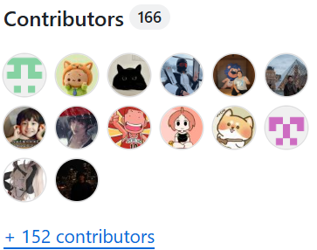
Contributors
Thanks to all the contributors who raised issues, participated in discussions, and submitted PRs!
…

Slide 7



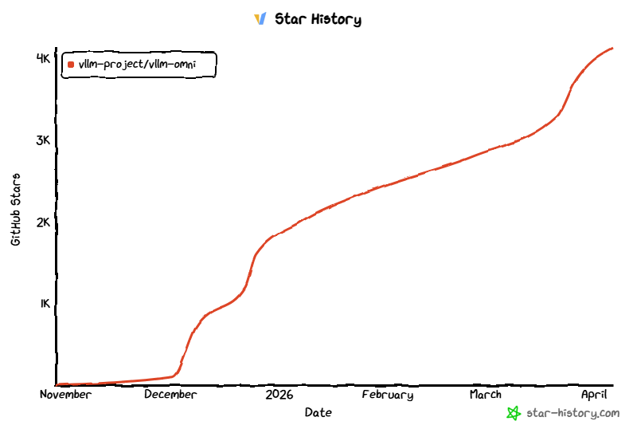
vLLM Github Repo
https://github.com/vllm-project/vllm-omni
$ uv pip install vllm==0.20.0 --torch-backend=auto
$ uv pip install vllm-omni
4700+ Stars
Official release

Slide 8
vLLM-Omni System Walkthrough
vLLM-Omni Team

Slide 9
Goal of the walkthrough
Understand how vLLM-Omni processes a multi-modal request and generates its multi-modal outputs.
2. Learn where to modify if you would like to make a specific modification/contribution.

Slide 10
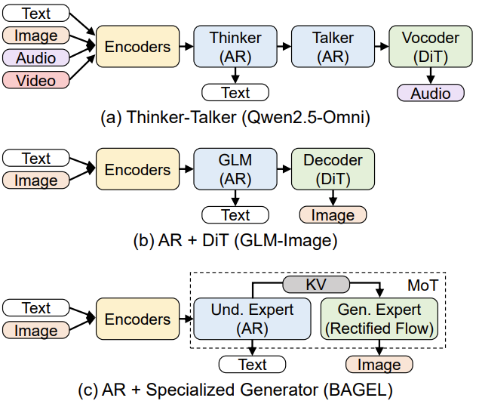
Multi-modality models
Backbone: (multi) AR + DiT
Models: Qwen-Omni/Ming-Omni
Tasks: any-to-any
Backbone: AR + DiT
Models: Qwen-Image/GLM-Image
Tasks: t2i, t2v, i2i...
Backbone: AR + Spec. Gen.
Models: BAGEL, Hunyuan Image 3.0
Tasks: t2i, i2i, i2t...
Yin, Peiqi, et al. "vLLM-Omni: Fully Disaggregated Serving for Any-to-Any Multimodal Models." arXiv preprint arXiv:2602.02204 (2026).

Slide 11
Multi-modality models: AR/DiT comparison
 | AR | DiT
Use cases | Text generation | Multi-modelity generation
Generation process | Token-by-token KV Cache based | Diffusion step
Bottleneck | Prefill: compute bound Decode: memory bound | Compute bound
Seq length | varied | Fixed
Attention Mask | causal mask | Full mask
parallelism | TP/DP/EP/PP/CP/SP | TP/EP/USP/CFG

Slide 12
Main architecture of vLLM-Omni
vLLM-Omni
Main component
Entrypoints: offline/online serving, StageClient abstraction for model stages(AR/DiT). One runtime, multiple interfaces.
AR module: inherited from vLLM(CB/PA/Prefix Cache…) and adapted to the Omni-modality model
Diffusion module: implemented natively and optimized by acceleration components
Model/Layer/ops: parallelism, quantization, attention…
OmniConnector: natively supports E/P/D/G disaggregation
EntryPoints
APIServer
Omni/AsyncOmni
Orchestrator
AR
Diffusion
LLMEngine
DiffusionEngine
Scheduler
Cache Engine
Scheduler
Executor
Worker
Worker
ModelRunner
ModelRunner
/Pipeline
Model/Layer/Ops
OmniConnector（E/P/D/G）
imported
modified
new

Slide 13
Interface Design
End-user Interface vllm_omni/entrypoints
Developer Interface vllm/engine
Synchronous
Omni
entrypoints/omni.py
AsyncOmniEngine
engine/async_omni_engine.py
Orchestrator
Batched inference
openai_api_server
entrypoints/openai/
api_server.py
StageEngineCoreClient
StageDiffusionClient
AsyncOmni
vllm_omni/entrypoints/async_omni.py
Asynchronous
StageEngineCoreProc
StageDiffusion
Proc
OpenAI-compatible API server
async def generate()
async def abort()
+ background engine loop
def add_request()
def abort_requests()
def step()
User custom server

Slide 14
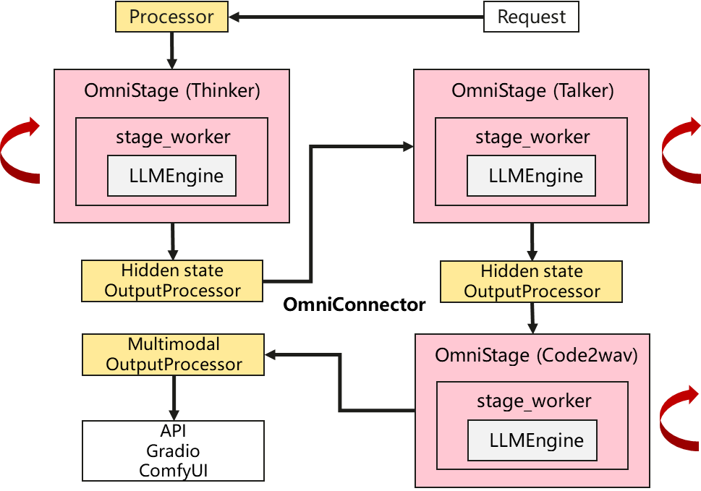



When requests arrive
Example: Qwen3-Omni
StageClient
StageClient
EngineCoreProc
EngineCoreProc
Code2Wav
EngineCore
EngineCore
AR-decoder(Talker)
AR-decoder(Thinker)
StageClient
Text
Tokenizer
Visual
Encoder
Audio
Encoder
EngineCoreProc
EngineCore

Slide 15
Two-level Config system for Qwen3-Omni
PR #2383
Deploy Config: For setting of different deployment tasks, exposed to users
OmniStage_0:
Thinker
OmniStage_1:
Talker
OmniStage_2:
Code2wav
- stage_id: 0
gpu_memory_utilization: 0.9
devices: "0"
default_sampling_params:
temperature: 0.4
top_p: 0.9
top_k: 1
max_tokens: 2048
seed: 42
repetition_penalty: 1.05
- stage_id: 1
gpu_memory_utilization: 0.6
devices: "1"
input_connectors:
from_stage_0: connector_of_shared_memory
default_sampling_params:
temperature: 0.9
top_k: 50
max_tokens: 4096
seed: 42
repetition_penalty: 1.05
- stage_id: 2
gpu_memory_utilization: 0.1
max_num_seqs: 1
enforce_eager: true
async_scheduling: false
max_num_batched_tokens: 51200
devices: "1"
input_connectors:
from_stage_1: connector_of_shared_memory
default_sampling_params:
temperature: 0.0
top_p: 1.0
top_k: -1
max_tokens: 65536
seed: 42
repetition_penalty: 1.1
https://github.com/vllm-project/vllm-omni/blob/main/vllm_omni/deploy/qwen3_omni_moe.yaml

Slide 16
Two-level Config system for Qwen3-Omni
Pipeline Config: For organizing data and computing pipeline of certain model, exposed to developers
OmniStage_0:
Thinker
OmniStage_1:
Talker
OmniStage_2:
Code2wav
StagePipelineConfig(
stage_id=0,
model_stage="thinker",
execution_type=StageExecutionType.LLM_AR,
input_sources=(),
final_output=True,
final_output_type="text",
owns_tokenizer=True,
requires_multimodal_data=True,
hf_config_name="thinker_config",
engine_output_type="latent",
…)
StagePipelineConfig(
stage_id=1,
model_stage="talker",
execution_type=StageExecutionType.LLM_AR,
input_sources=(0,),
hf_config_name="talker_config",
engine_output_type="latent",
custom_process_input_func=f“{_PROC}.thinker2talker”, custom_process_next_stage_input_func=(f"{_PROC}.talker2code2wav_async_chunk"),
sampling_constraints={
"detokenize": False,
"stop_token_ids": [2150],
},
)
StagePipelineConfig(
stage_id=2,
model_stage="code2wav", execution_type=StageExecutionType.LLM_GENERATION,
input_sources=(1,),
final_output=True,
final_output_type="audio",
hf_config_name="thinker_config",
engine_output_type="audio",
custom_process_input_func=f"{_PROC}.talker2code2wav",
sampling_constraints={"detokenize": True},
)
https://github.com/vllm-project/vllm-omni/blob/main/vllm_omni/model_executor/models/qwen3_omni/pipeline.py

Slide 17
Natively Disaggregated Serving
PR #215
#979
Standardized Unified Abstraction: A generalized interface that handles heterogeneous data (Text, Image, Audio).
Control & Data Plane Decoupling: Metadata travels via lightweight control signals, while heavy payloads are offloaded to high-performance data planes.
Hybrid Backend Support: Native support for Shared Memory (SHM) and Mooncake for distributed transfers.
Disaggregated Multi-Modal Execution: Enables seamless communication between decoupled stages.
Multi-Instance Scaling: Supports multiple instances for each omni stage, enabling elastic deployment and efficient load distribution across distributed clusters.
APIServer/AsyncOmni
async.io
PipelineOrchestrator（multi-stage）
ZMQ IPC
ZMQ IPC
ZMQ IPC
StageEngine-1
StageEngine-2
StageEngine-K
Scheduler
Scheduler
Scheduler
Worker
Worker
Worker
ModelRunner
ModelRunner
ModelRunner
…
OmniConnector
OmniConnector
OmniConnector
N_1
N_2
N_k
Memory Pool
Transfer engine
Meta data flow
D2H2D flow
D2D flow

Slide 18
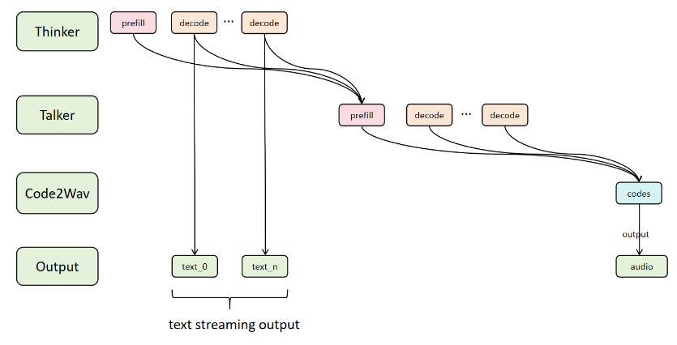
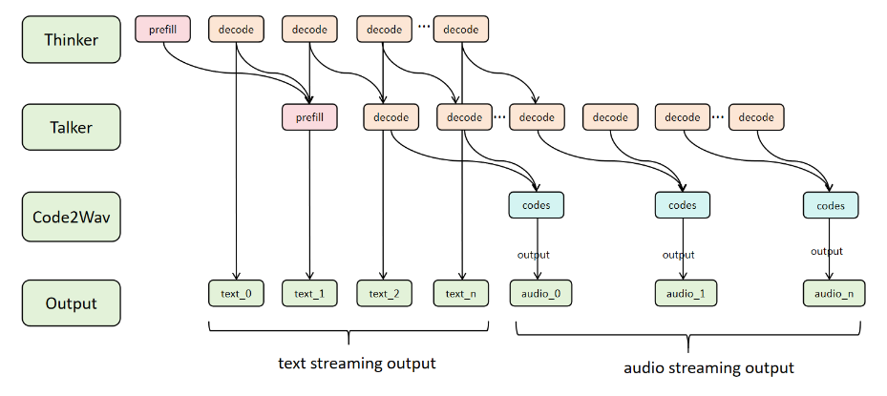
Async Chunk & Audio Streaming Output
PR #367
#727
#951
#1438
Pipeline Between Stages: Asynchronous chunked computation and communication across stages
Audio Streaming Output: The waveform is output immediately after Talker generates each token.
APIServer Support: OpenAI v1/chat/completions with “stream” argument
E2E generation
Streaming generation

Slide 19
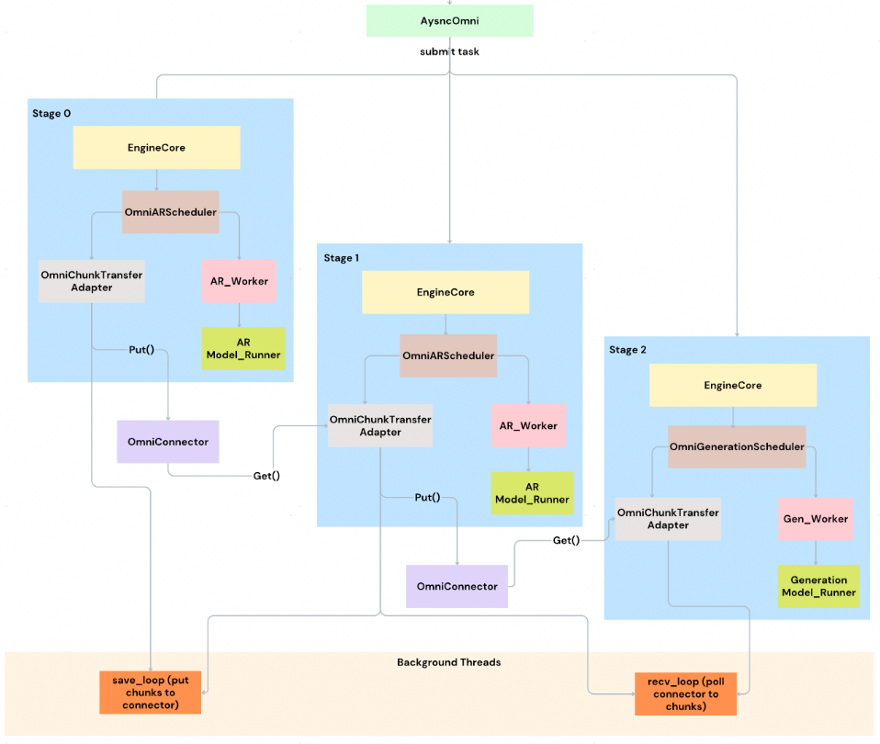
Async Chunk & Audio Streaming Output
OmniConnector: Transmit data between stages.
OmniChunkTransferAdapter: Chunk-specific implementation that owns the full chunk lifecycle when async_chunk is enabled.
Stage Input Processors: Custom functions that process stage outputs into chunks for different models.
Schedulers: Modified to handle chunk-based scheduling with async IO-compute overlap.
Model Runners: Handle chunk processing.

Slide 20
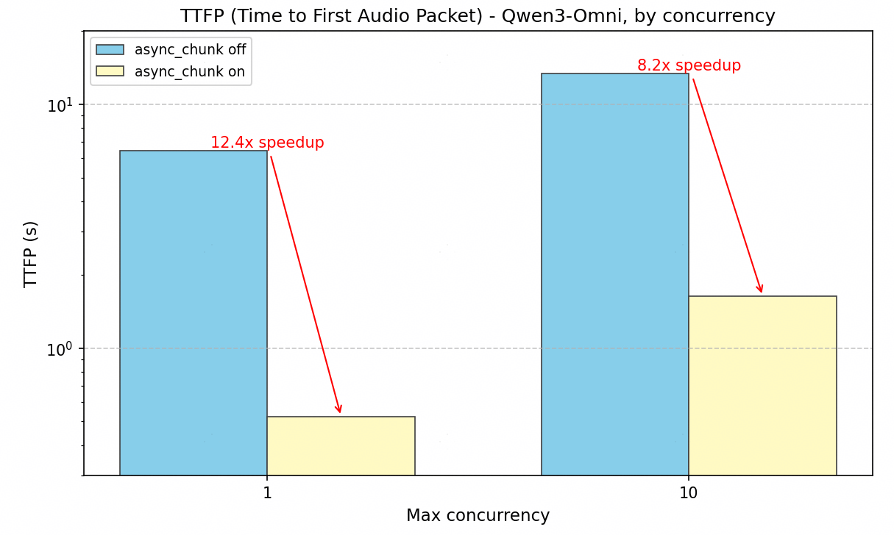
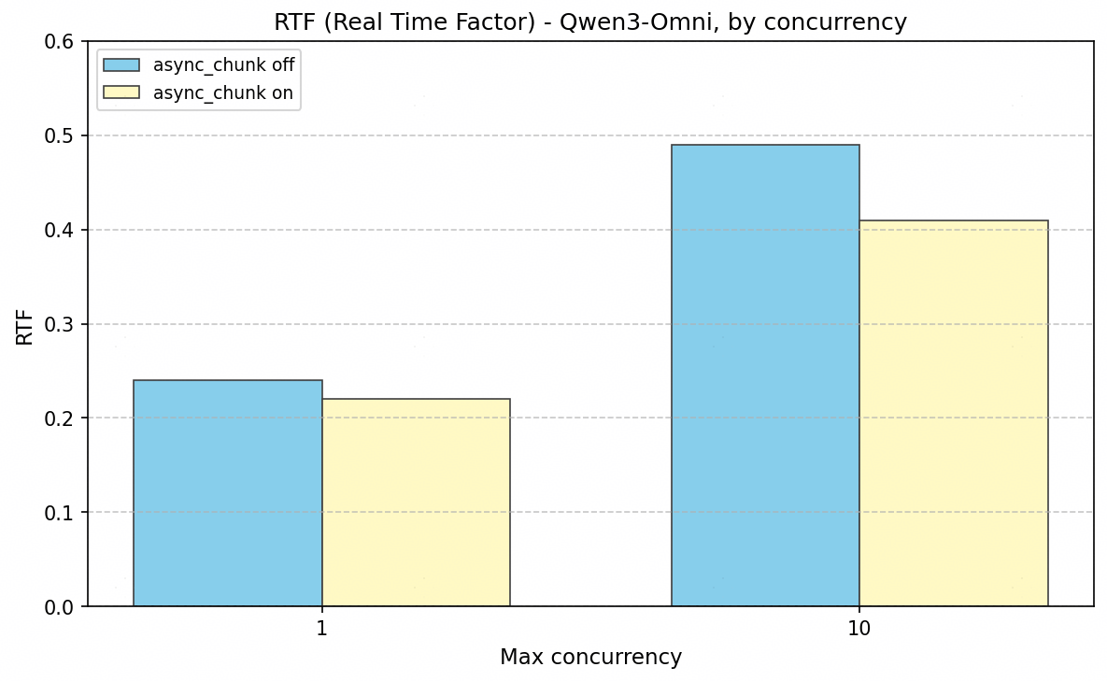
Async Chunk & Audio Streaming Output
Qwen3-Omni
1 / 10 concurrency: 12.4x / 8.2x improves
1 / 10 concurrency: 1.1 x / 1.2 x improves
https://docs.vllm.ai/projects/vllm-omni/en/latest/design/feature/async_chunk_design/

Slide 21
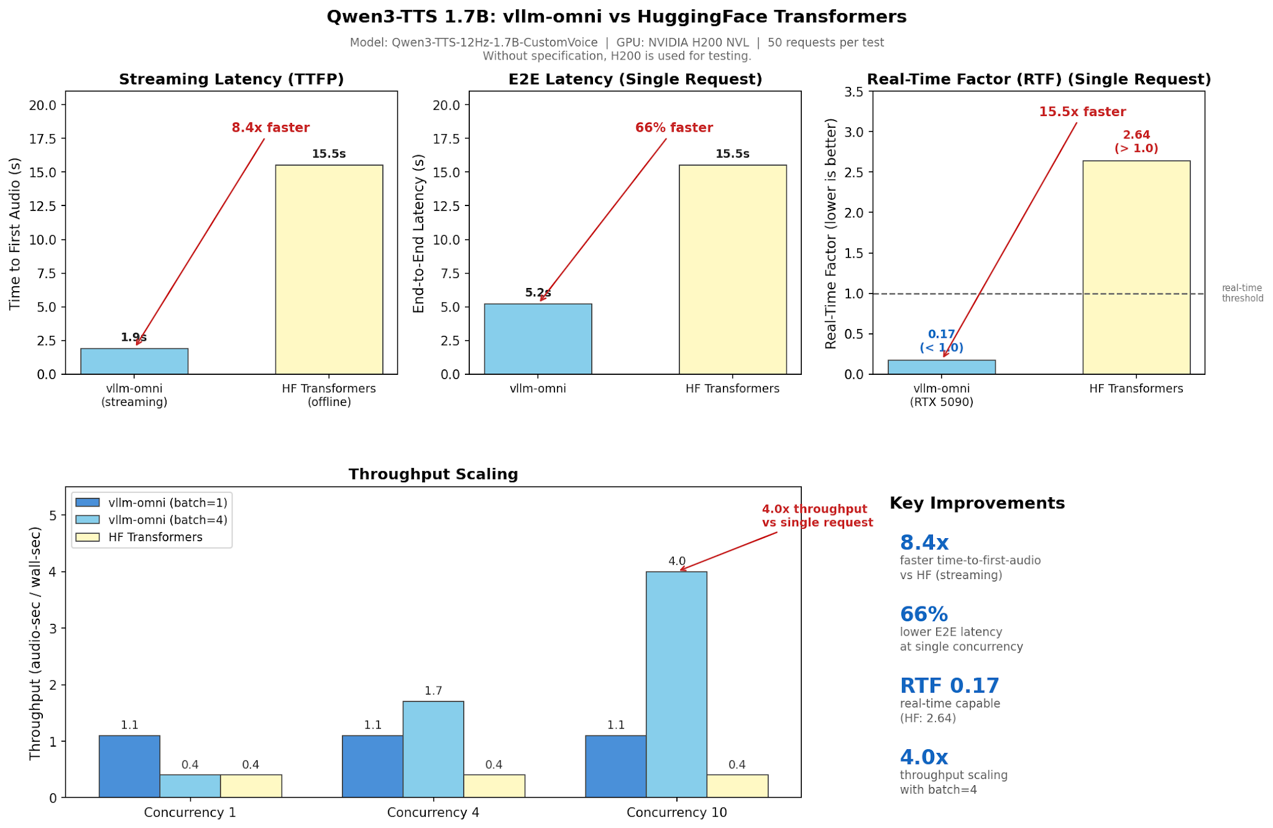
PR #1161
#1591
#1617
Async Chunk & Audio Streaming Output
Qwen3-TTS

Slide 22
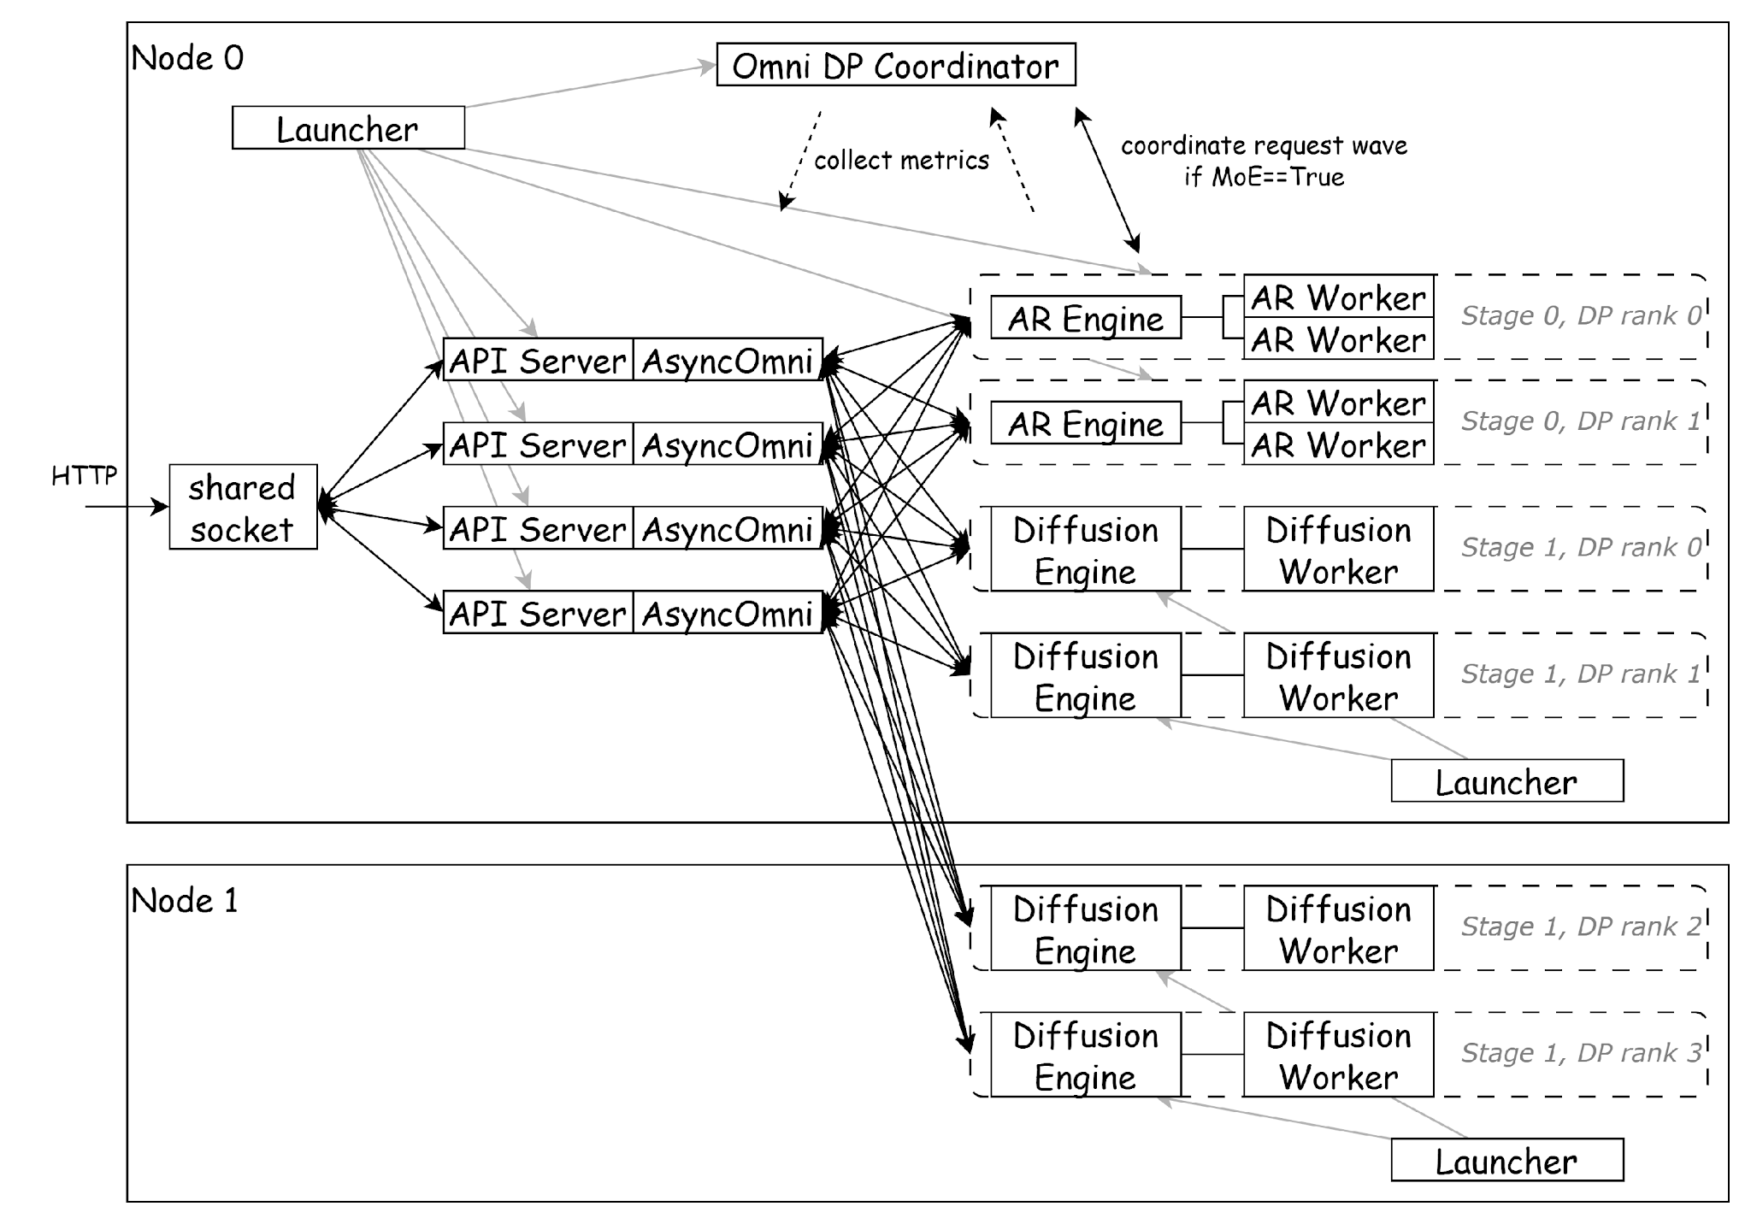
Scaling Disaggregated Serving
Example Multi-Node Deployment Diagram
Command Line Interface (CLI) Design (PR #2020)
Distributed Deployment Structure
a. Multiple APIServers (PR #2020)
b. DP based Scaling for OmniStage
c. Coordinator for global management
Scheduling & Routing for load balancing

Slide 23
Omni-Modality models Acceleration Support
Model | Output Modalities | Disaggregated deployment | Streaming | Async chunk | Graph | Quantization | NPU Support
Qwen2.5-Omni | Text/Audio | ✅ | Only text | ❌ | ❌ | ❌ | ✅
Qwen3-Omni | Text/Audio | ✅ | ✅ | ✅ | ✅ | ✅ | ✅
MiMo-Audio | Text/Audio | ✅ | ✅ | ✅ | ✅ | ❌ | ❌
Qwen3-TTS | Audio | ✅ | ✅ | ✅ | ✅ | ⏳ | ✅
Bagel | Text/Image | ✅ | Only text | N/A | Only AR | ❌ | ❌
GLM-Image | Image | ✅ | N/A | N/A | ✅ | ⏳ | ✅
Hunyuan-Image | Text/Image | ✅ | Only text | N/A | Only AR | ⏳ | ✅
✅ = supported
❌ = not yet supported
⏳ = in progress (PR under review)

Slide 24
Diffusion Module Design
Diffusion Engine
Diffusion Core
Natively implemented and optimized by configuring the acceleration layer
Aligned with the AR arch with model_runner abstraction
Encoders are disaggregated to run on vllm engine for higher throughput in large-scale deployment
Support step-wise scheduler with continuous batch for higher SLA
Connect with AR module to speed up AR+DIT model inference with OmniConnector
Acceleration Features
Cache backend: Cache-DiT, TeaCache…
Parallelism: TP/HSDP/SP/CFG/VAE…
Attention: interface abstraction for third-party integration(FA/SAGE/MindIE-SD…)
Quantization: FP8/GGUF…
CPU Offload: module-wise/layer-wise
Extensions: LoRA
Scheduler(step-wise)
Diffusion Worker
Diffusion Model Runner
Diffusion Pipeline
Prompt Encode
embed
N-step Sampling
latent
VAE Decode
DiT
Acceleration Features
Cache Backend
Parallelism
Quantization
(FP8/GGUF)
TP
CacheDiT
HSDP
CFG
SP
VAE
TeaCache
Attention Backend
CPU Offload
(module-wise/
layer-wise)
Extensions
SDPA
FA
Sparse
LoRA
vllm import
native
Third-party
Notes:
从上到下调度的框架是相同的： scheduler做请求调度，根据worker的状态和负载决定把请求发给哪个Worker woker 一个worker进程跑一个diffusion pipeline
diffusion pieline和DiT模型的实现方式不同： 方案1：直接用diffusers DifffusinPipeline，通过diffusers的from_pretrained，generation支持各种生图/视频模型。其中把text encoder替换为vllm的实现；直接调第三方兼容diffusers的加速库做Cache/并行加速 方案2：vllm-omni重新实现，用vllm和vllm-omni底层的并行layers，attention kernels，ops等重写dit模型，具体的并行，cache策略跟模型结构相关并深度优化

Slide 25
Diffusion Dynamic Batching
Motivation
Async arrival over time
Image/video requests arrive at different timestamps.
Synchronous DiffusionEngine execution misses batching opportunitiesand under-utilizes DiT compute.
Async
Diffusion
Engine
Scheduler
Worker
Pick compatible requests
across async arrivals
Request A
Request C
Request B
Request D
state manager
async_add_request()
(accept independently)
batch compatible
ready
same
shape
same
CFG
batch builder
t0
t1
t2
t3
time
…
Future per request
(created immediately)
Selected for next batch
(example)
Per-request lifestyle
waiting → scheduled → running → finished
A
C
D
Design
Engine accepts requests asynchronously.
Scheduler selects compatible requests across arrivals.
Worker manages states and builds InputBatch for step-wise execution.
Result C
t4.2
ModelRunner /
execute_stepwise()
InputBatch
Result A
t5.1
Out-of-order
return
(formed from async arrivals)
(process step by step)
A
C
D
Result D
t6.3
Result B
t7.8
Async arrival → dynamic batching → larger effective DiT batch → higher GPU utilization / MFU → higher throughput and lower latency. CPU batching overhead is negligible: make_batch < 1 ms vs. execute_stepwise ≈ 1000–1200 ms.
Return immediately
when finished
(resolve Futures)

Slide 26
parallelism
Parallel Methods | Core Description | Configuration Parameters
Tensor Parallelism (TP) | Distributed weight to multiple devices | tensor_parallel_size
Sequence Parallelism (SP) | Split the input along the sequence dimension. | ulysses_degree, ring_degree
Expert Parallelism (EP) | Only MoE Expert MLP Blocks | enable_expert_parallel
CFG-Parallelism | CFG's positive and negative branches are assigned to different GPUs. | cfg_parallel_size
HSDP | Hybrid Sharding Data Parallelism | use_hsdp, hsdp_shard_size
VAE Patch Parallelism | Cross-GPU Distributed VAE Encoding and Decoding | vae_patch_parallel_size
Core Compatibility Matrix
Wan2.2 supports
Method | TP | Ulysses | Ring | CFG | HSDP | EP | VAE Patch
TP | — | ✅ | ✅ | ✅ | ❌ | ✅ | ✅
Ulysses | ✅ | — | ✅ | ✅ | ✅ | ✅ | ✅
Ring | ✅ | ✅ | - | ✅ | ✅ | ✅ | ✅
CFG | ✅ | ✅ | ✅ | - | ✅ | ✅ | ✅
HSDP | ❌ | ✅ | ✅ | ✅ | — | ✅ | ✅
EP | ✅ | ✅ | ✅ | ✅ | ✅ | - | ✅
VAE Patch | ✅ | ✅ | ✅ | ✅ | ✅ | ✅ | -
Parallel Method | Wan2.2 Support
SP (Ulysses and Ring) | ✅
CFG - Parallel | ✅
Tensor Parallel | ✅
HSDP | ✅
VAE patch parallel | ✅
Expert parallelism | ❌
https://github.com/vllm-project/vllm-omni/issues/1217

Slide 27
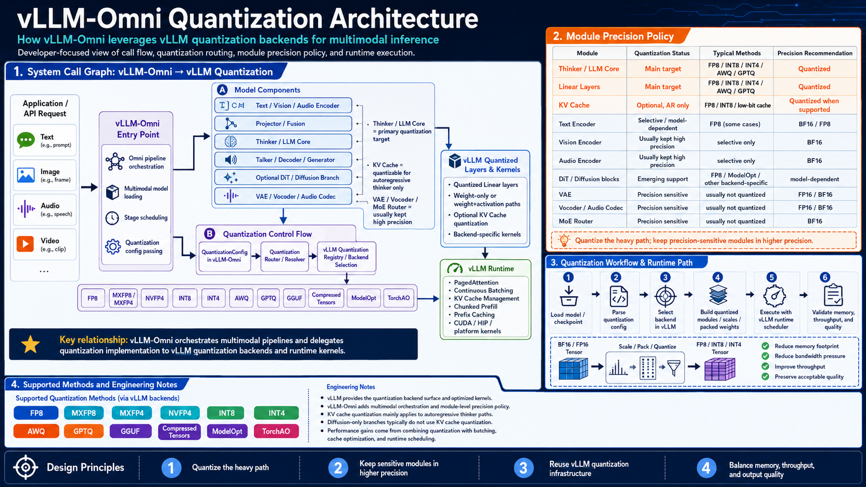
Quantization

Slide 28
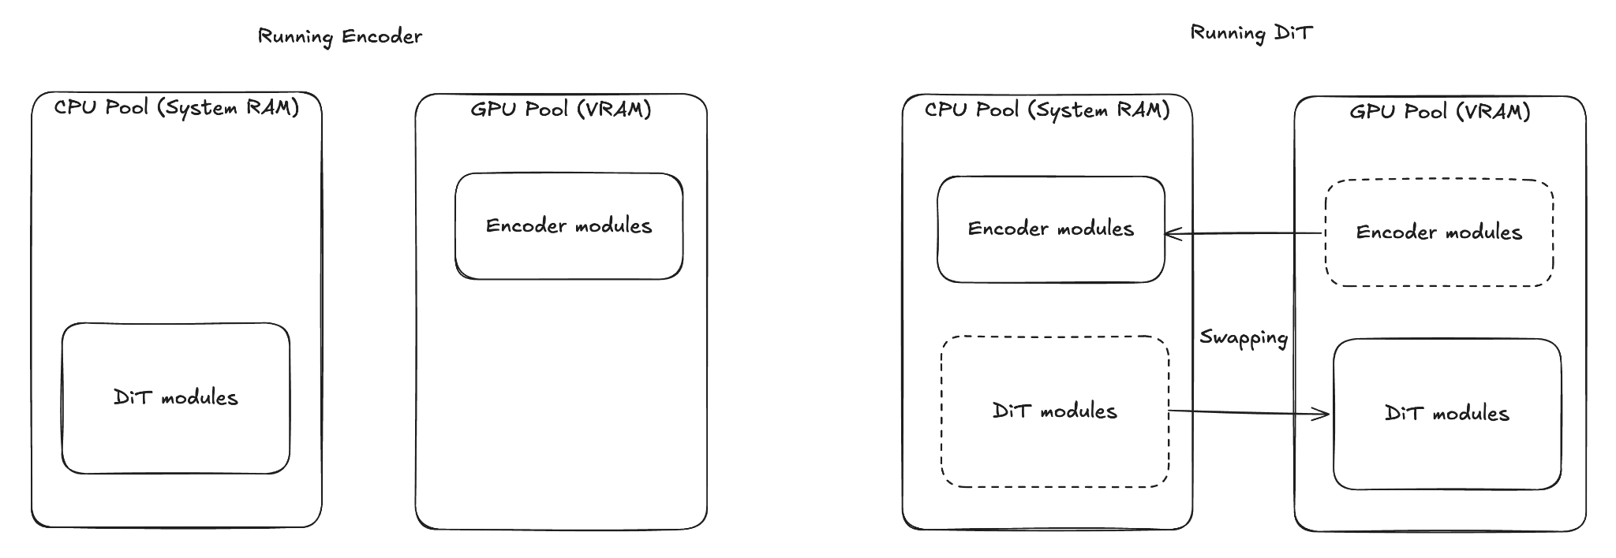
CPU offload Support(1)
Sequential Offloading (coarse-grained model component level)
Register offload targets on model component (e.g., Encoder/DiT/…)
Pre-Hooks registered: offload targets; move self to GPU

Slide 29
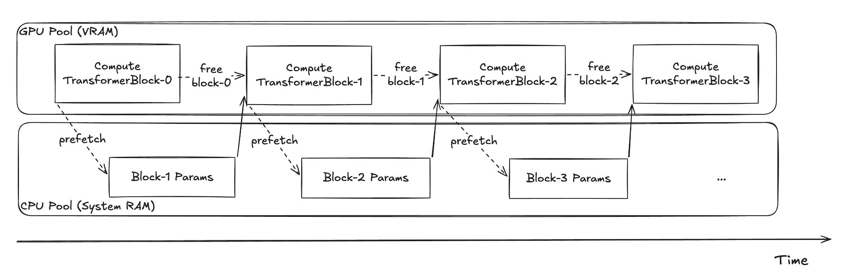
CPU offload Support(2)
Layerwise Offloading
Keep a single TransformerBlock on GPU during computing
Hooks registered: Pre-fetch params for the next block; release memory after computation

Slide 30
Diffusion modules with Acceleration Support
Model | Output modality | TeaCache | Cache-DiT | SP (Ulysses & Ring) | CFG-Parallel | TP | HSDP | VAE-Patch-Parallel | CPU Offload (Layerwise) | Quant (fp8/fp4…)
FLUX.1-dev | Image | ⏳ | ✅ | ❌ | ✅ | ✅ | ⏳ | ❌ | ❌ | ✅
FLUX.2-klein |  | ⏳ | ⏳ | ⏳ | ✅ | ✅ | ⏳ | ❌ | ❌ | ✅
LongCat-Image |  | ❌ | ✅ | ✅ | ✅ | ✅ | ⏳ | ❌ | ❌ | ❌
LongCat-Image-Edit |  | ❌ | ✅ | ✅ | ✅ | ✅ | ⏳ | ❌ | ❌ | ❌
Qwen-Image |  | ✅ | ✅ | ✅ | ✅ | ✅ | ✅ | N.A. | ✅ | ✅
Qwen-Image-Edit |  | ✅ | ✅ | ✅ | ✅ | ✅ | ✅ | N.A. | ✅ | ✅
Qwen-Image-Layered |  | ❌ | ✅ | ✅ | ✅ | ✅ | ⏳ | N.A. | ✅ | ❌
SD3.5 |  | ⏳ | ✅ | ⏳ | ✅ | ✅ | ⏳ | ❌ | ❌ | ❌
NextStep1.1 |  | ⏳ | ⏳ | ❌ | ❌ | ✅ | ⏳ | ❌ | ❌ | ❌
Z-Image |  | ✅ | ✅ | ✅ | ❌ | ✅ | ⏳ | ✅ | ❌ | ✅
Wan2.2 | Video | ❌ | ✅ | ✅ | ✅ | ✅ | ✅ | ✅ | ✅ | ✅
HunyuanVideo1.5 |  | ⏳ | ✅ | ✅ | ✅ | ✅ | ✅ | ❌ | ⏳ | ⏳
Seed-Helios |  | ❌ | ❌ | ❌ | ❌ | ⏳ | ❌ | ❌ | ❌ | ⏳
https://docs.vllm.ai/projects/vllm-omni/en/latest/user_guide/diffusion_features/#imagegen

Slide 31
Hardware plugin system
vLLM-Omni
EntryPoints
Hardware Platform
APIServer
Omni/AsyncOmni
vLLM-Omni Plugin Interface
OmniStage
AR
Diffusion
NPU/XPU/ROCm
LLM Engine
Diffusion Engine
Worker
Scheduler
Cache Engine
Scheduler
Model Runner
Executor
Executor
Custom Layer
Worker
Model Runner
Worker
Model Runner
Plugin
Custom kernels
Attention
Pluggable Layer
IR
Attention Backend
OmniConnector（E/P/D/G）
‹#›
Pluggable

Slide 32
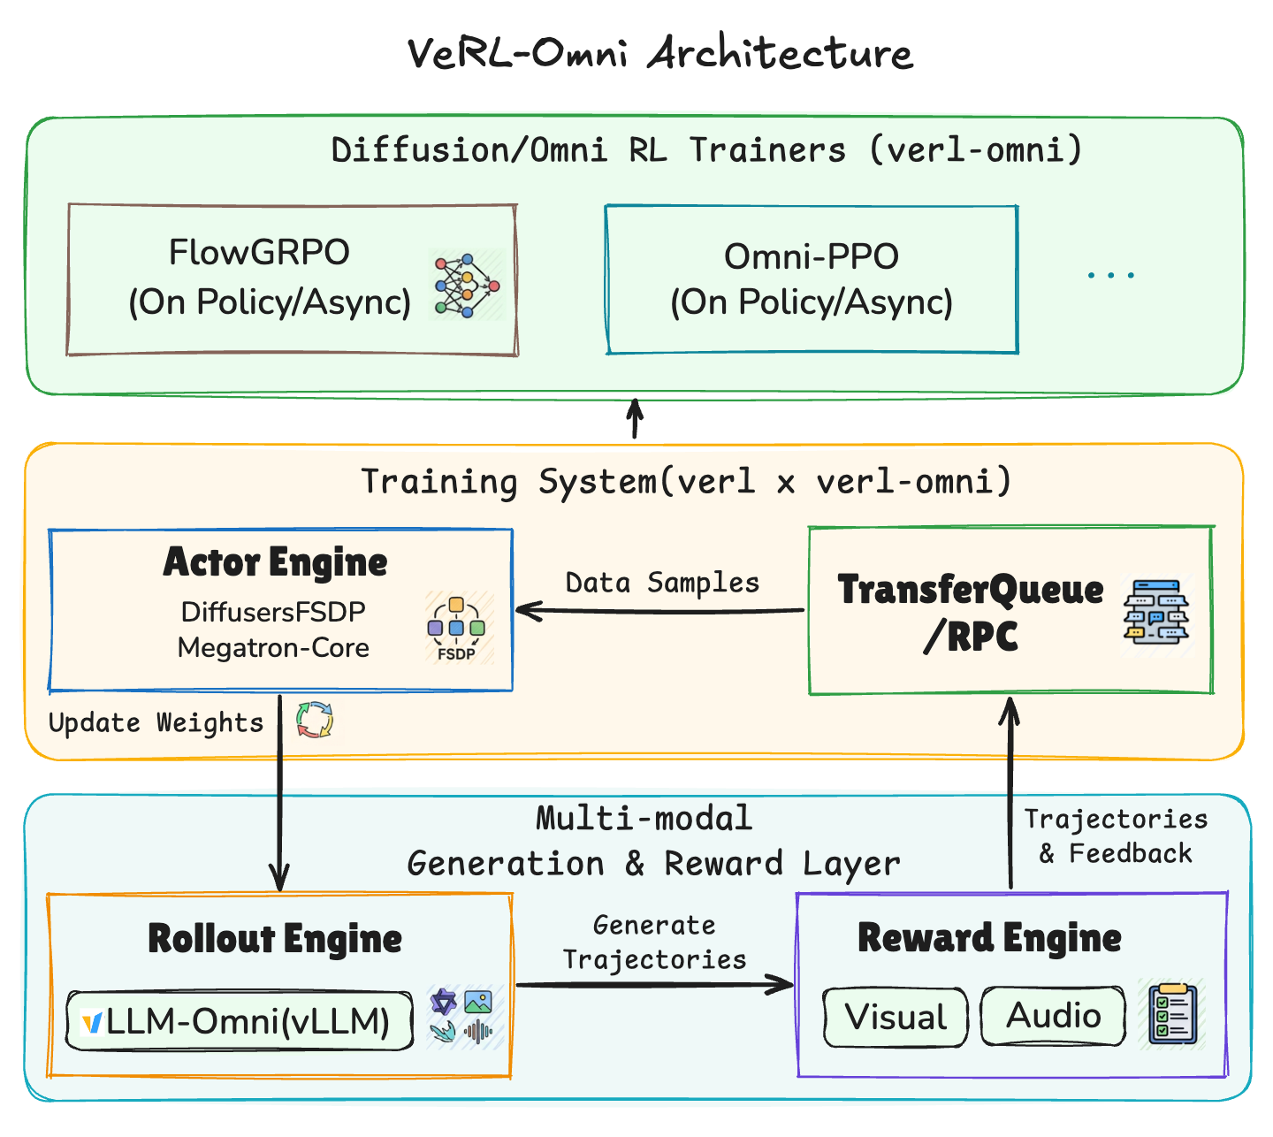
RL Support: VeRL-Omni
Key Features
Efficient multimodal rollout: vLLM-Omni provides high-throughput async serving for multimodal generation
Modular training engines: allow easy integration of parallelism(FSDP/SP) and other optimizations for various diffusion models
Flexible reward engine: supports both rule-based and model-based reward computations
Fast diffusion RL trainers: FlowGRPO trainer achieves ~25% higher E2E training throughput than the diffusers-based implementation
Ongoing
Model support: Qwen3-Omni, BAGEL, …
Algorithm support: GSPO, MixGRPO, …
Fully async for efficient diffusion/omni-modality RL
Training stability: deterministic, staleness control, …
Hardware support: NPU
…
https://github.com/verl-project/verl-omni Welcome contributions!

Slide 33
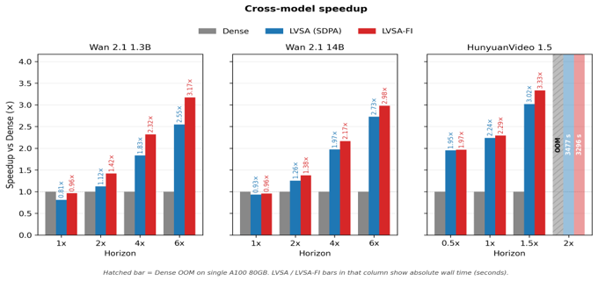
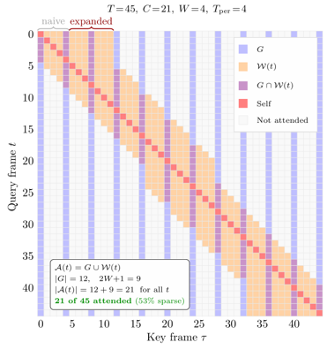
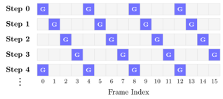
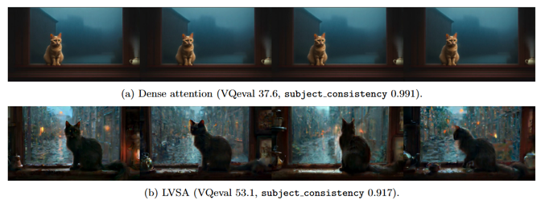
LVSA — Long-Video Sparse Attention
Training-free block-sparse attention for long-video diffusion – vLLM-Omni plugin
PR4192
Problem: Dense Attention Hits a Wall
Quadratic Compute. Attention over N = T×P tokens scales as O(N²).
Quality Collapse. Beyond training horizon, dense → ‘frozen video’.
Capability Wall at 14B Scale. Dense 14B at 2×: 72.9 GB. Dense at 4×+: > 2h on single GPU. Long-video serving = not viable at dense cost.
Plugin for versions 0.18.0 & 0.22.0,
support Wan 2.X, HunyuanVideo on NPU and GPU
Key1: Adaptive Expanded Sparse Pattern
Key2: Rotating Keyframes
Eliminates long-range temporal artifacts while keeping per-step attention budget constant.
https://arxiv.org/abs/2605.31057
https://github.com/JiusiServe/LongVideoSparseAttention

Slide 34
Summary
Support Omni-Modality model inference & serving
Consistent and unified API interface with vLLM
Native disaggregated deployment for different model stages
Pipeline async streaming for multiple stage engines
Native support for diffusion stage acceleration

Slide 35
vLLM-Omni 0.20.0 release
vLLM-Omni Team

Slide 36
vllm-omni 0.20.0 release highlights（1）
Rebased to upstream vLLM v0.20.0, with CUDA 13.0 and PyTorch 2.11 alignment, Transformers 5.x compatibility fixes, removal of the old vLLM entrypoint hijack, and runtime changes needed for the 0.20.0 integration path. (#3232, #3082, #3352, #3393, #2306)
CLI and configuration refactor, including the stage CLI refactor, forwarding CLI tokenizer settings into per-stage engine configs, removal of legacy Omni CLI helpers, cleaner deploy/pipeline config migration, and updated CLI documentation. (#2020, #3120, #3144, #2383, #2978)
Hardware plugin and platform optimization, expanding MUSA flash attention and torch.accelerator support, aligning NPU with the v0.20.0/GPU model-runner path, restoring ROCm/AMD CI signal, and refreshing XPU Docker/CI readiness for the PyTorch 2.11 stack. (#2451, #3101, #3325, #3343, #3083, #3393)
More SOTA model support, including Ming-flash-omni-2.0, XiaomiMiMo/MiMo-V2.5-ASR, MOSS-TTS-Nano, VoxCPM2 native AR TTS, HunyuanImage-3.0 IT2I, ERNIE image T2I, AudioX, Wan2.2-S2V, DreamID-Omni HSDP, LTX-2.3, and FastGen Wan 2.1 pipelines. (#2890, #3089, #2753, #2658, #3107, #2861, #2077, #2751, #3138, #2893, #2749)

Slide 37
vllm-omni 0.20.0 release highlights（2）
Diffusion continuous batching: adding async batch inference in the DiffusionEngine and strengthening step-level/diffusion serving paths with pipeline-declared offload modules, achieved a 7.8% increase in throughput and a 5.8% reduction in mean latency compared to the baseline. CFG/HSDP improvements, VAE tiling, and performance validation. (#2729, #2707, #2427, #2423, #2368, #2899, #2982)
Large-scale serving for Qwen3-Omni, by scaling stages such as talker and code2wav with multiple replicas, this change improves overall throughput for Qwen3-Omni deployment on H20 GPU at 32 concurrency from 0.241 req/s to 0.414 req/s (+72%), while also increasing per-GPU efficiency to 0.138 req/s/GPU (+14%). (#3203, #2376, #3306, #2396, #2598, #2600)
Expanded quantization coverage, including AutoRound W4A16 support for Qwen Omni, offline W4A16 quantized model support, OmniGen2 FP8, Z-Image text-encoder FP8 online quantization, HunyuanImage3 NPU quantization, GLM-Image quantization, and fixes for pre-quantized checkpoints. (#2670, #1777, #2441, #3279, #2979, #2292, #2702, #2795)

Slide 38
vllm-omni 0.20.0 release highlights（3）
TTS model speedups, improving through native decoder construction, CUDA graph capture and shared memory pools, streaming VAE with full-graph, global speaker/reference-audio caches, and deterministic Fast AR sampling, delivering roughly 9x VoxCPM2 RTF reduction (0.946 → 0.106 on H20), -53% Fish Speech Fast AR latency, and ~3.2 GiB Code2Wav memory savings for Qwen3-TTS/Voxtral-TTS. (#2690, #2758, #2803, #2341, #2630, #2657, #2520)
Omni model optimization, enable async scheduling and uni process executor to align with upstream AR performance, delivering TTFT/TPOT 50% reduction. (#3164, #3203)
Wan2.2 on NPU is now production-ready with major I2V performance optimizations, including MindIE-SD LA, fused RoPE/AdaLayerNorm/RMSNorm, VAE BF16 and parallelism fixes, HSDP/USP deployment recipes, delivering 50-60% performance improvement. (#2919, #2393, #2459, #2391, #2585, #2583, #2571, #3067, #2969, #2852, #3063, #2262, #2817)

Slide 39
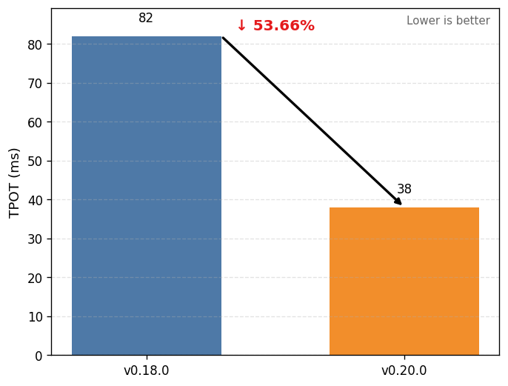
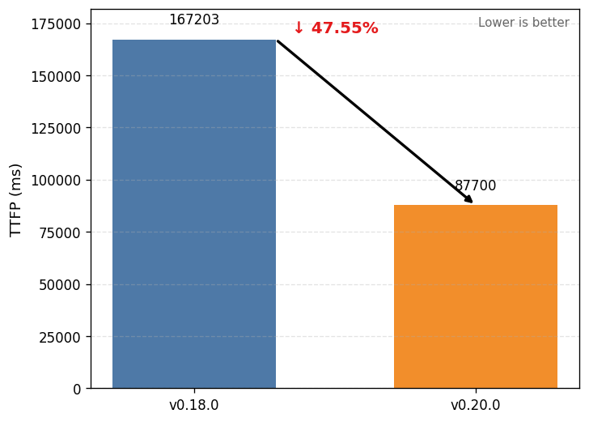
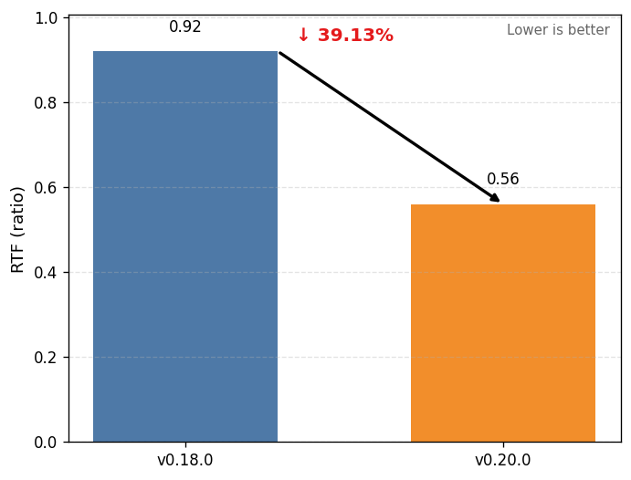
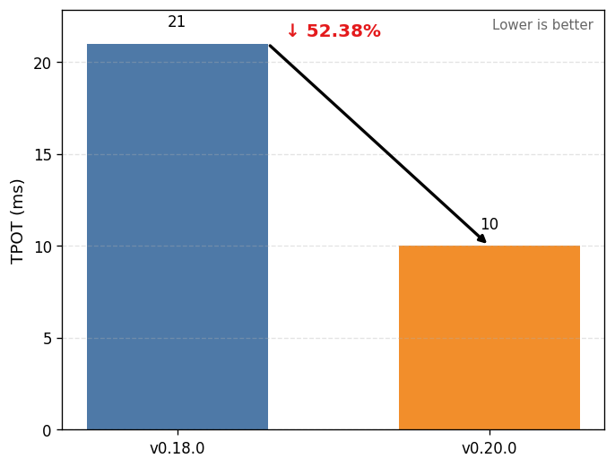
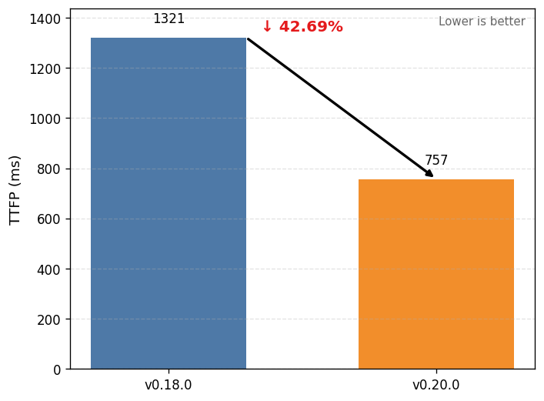
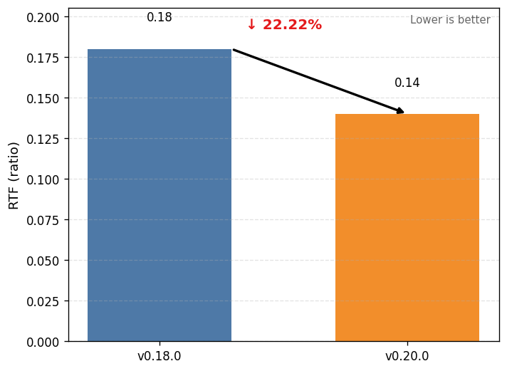
Qwen3-Omni
High throughput (Concurrency 32)
Low latency(Concurrency 1)
The experiments were run on two NVIDIA H100 GPUs.

Slide 40
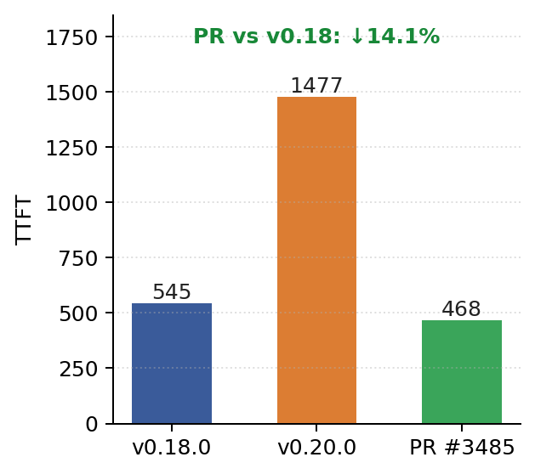

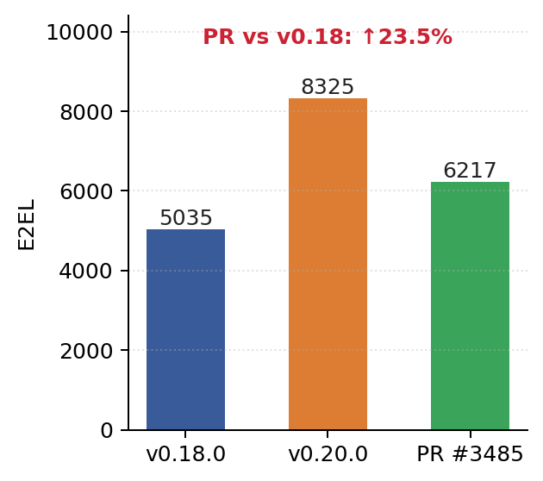
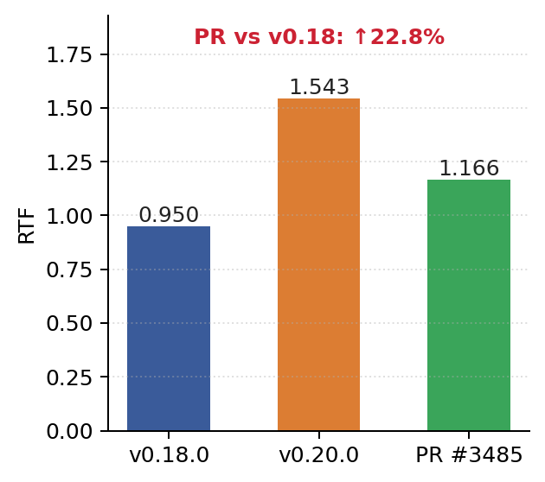
Qwen3-TTS
High throughput (Concurrency 32)
Low latency(Concurrency 1)
The experiments were run on Single H20 GPU.

Slide 41
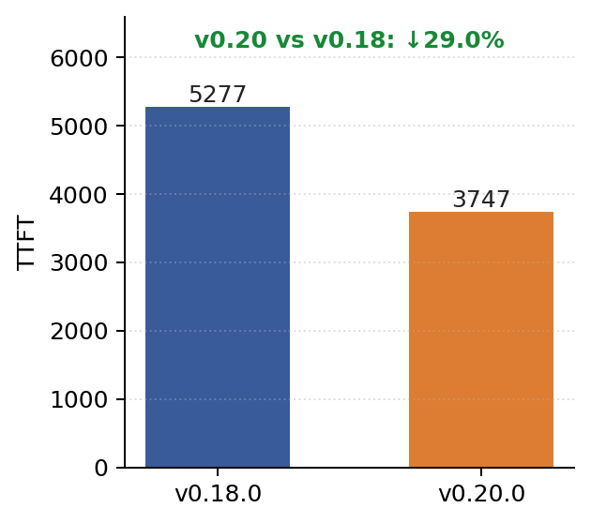

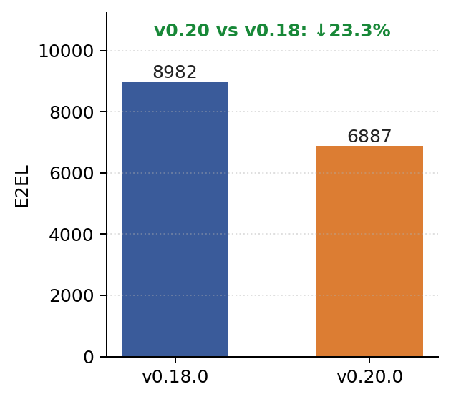
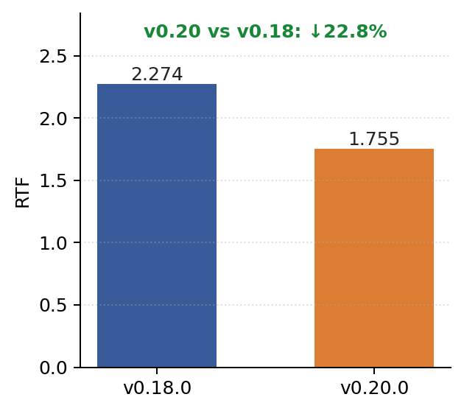
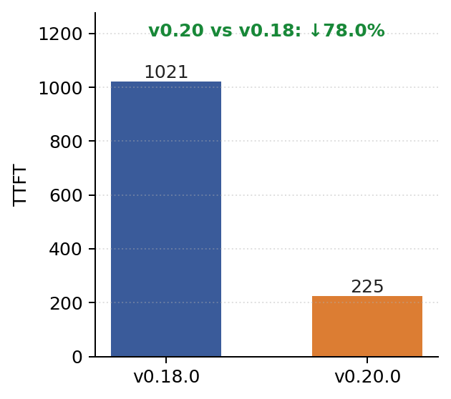
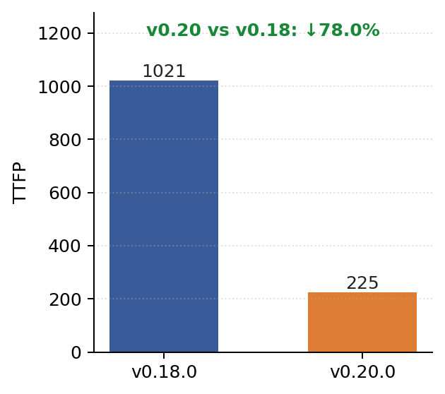
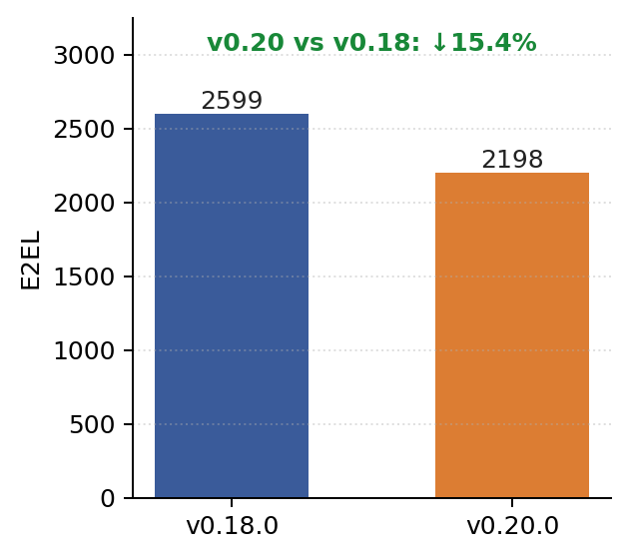
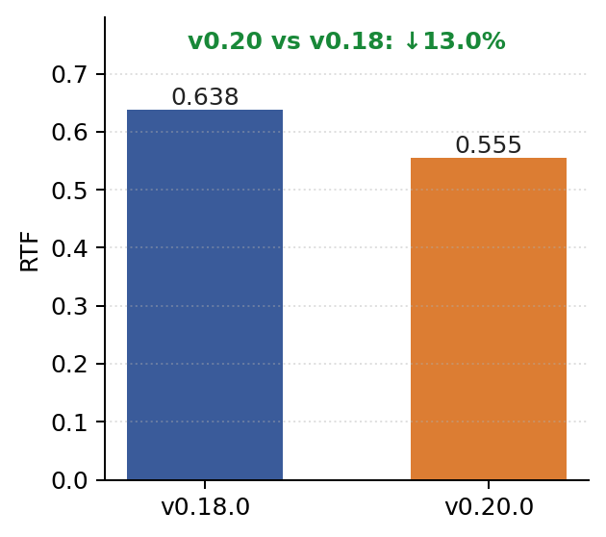
Fish Speech S2 Pro
High throughput (Concurrency 8)
Low latency(Concurrency 1)
The experiments were run on Single H20 GPU.

Slide 42
Diffusion models

Slide 43
vLLM-Omni Roadmap
vLLM-Omni Team

Slide 44
Future Roadmap (Overview)
P0:
CI/CD: Performance monitoring
Large scale deployment
Diffusion continuous batching
Quantization(fp8/fp4/autoround w4a16…)
P1:
Auto-regressive DiT models (interactive/world models)
Diffusers backend support
ModelRunnerV2 fully support
Video streaming input/output
https://github.com/vllm-project/vllm-omni/issues/2136

Slide 45






vLLM Networking Hour!
https://github.com/vllm-project/vllm-omni
https://blog.vllm.ai/2025/11/30/vllm-omni.html
https://communityinviter.com/apps/vllm-dev/join-vllm-developers-slack

